Slide 1
Domain Adaptive Object Detection
Yunlong MENG
2023-02-08

Slide 2
Outline
Discrepancy-based domain adaptive object detection
Diminish the domain shift by finetuning the deep network based detection model with labeled or unlabeled target data
Adversarial-based domain adaptive object detection
Utilize domain discriminators and conduct adversarial training to encourage domain confusion between source domain and target domain
Reconstruction-based domain adaptive object detection
Improve the domain adaptive object detection by reconstructing the source samples or target samples
Hybrid domain adaptive object detection
Use two or more above domain adaptation mechanisms simultaneously to achieve superior performance
Other domain adaptive object detection
Graph-induced protory alignment
Categorical regularization
......

Slide 3
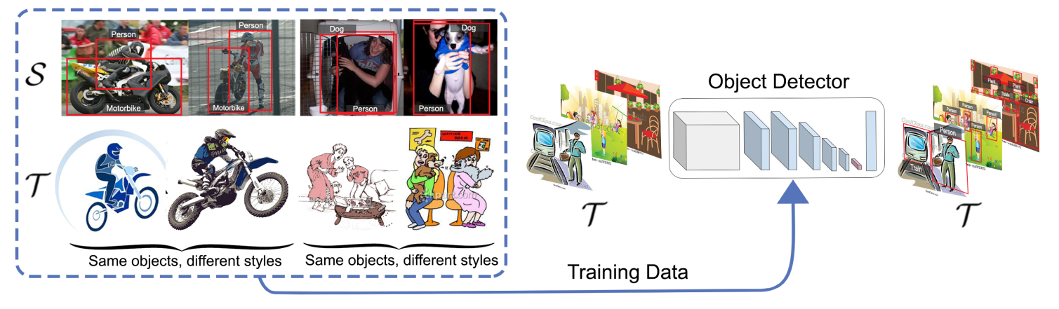
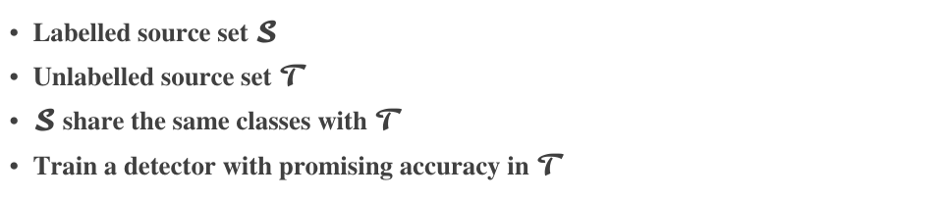
Cross domain object detection problem formulation
Labelled source set $𝓢$
Unlabelled source set $𝓣$
$𝓢$ share the same classes with $𝓣$
Train a detector with promising accuracy in $𝓣$
Rodriguez et al. BMVC 2019

Slide 4
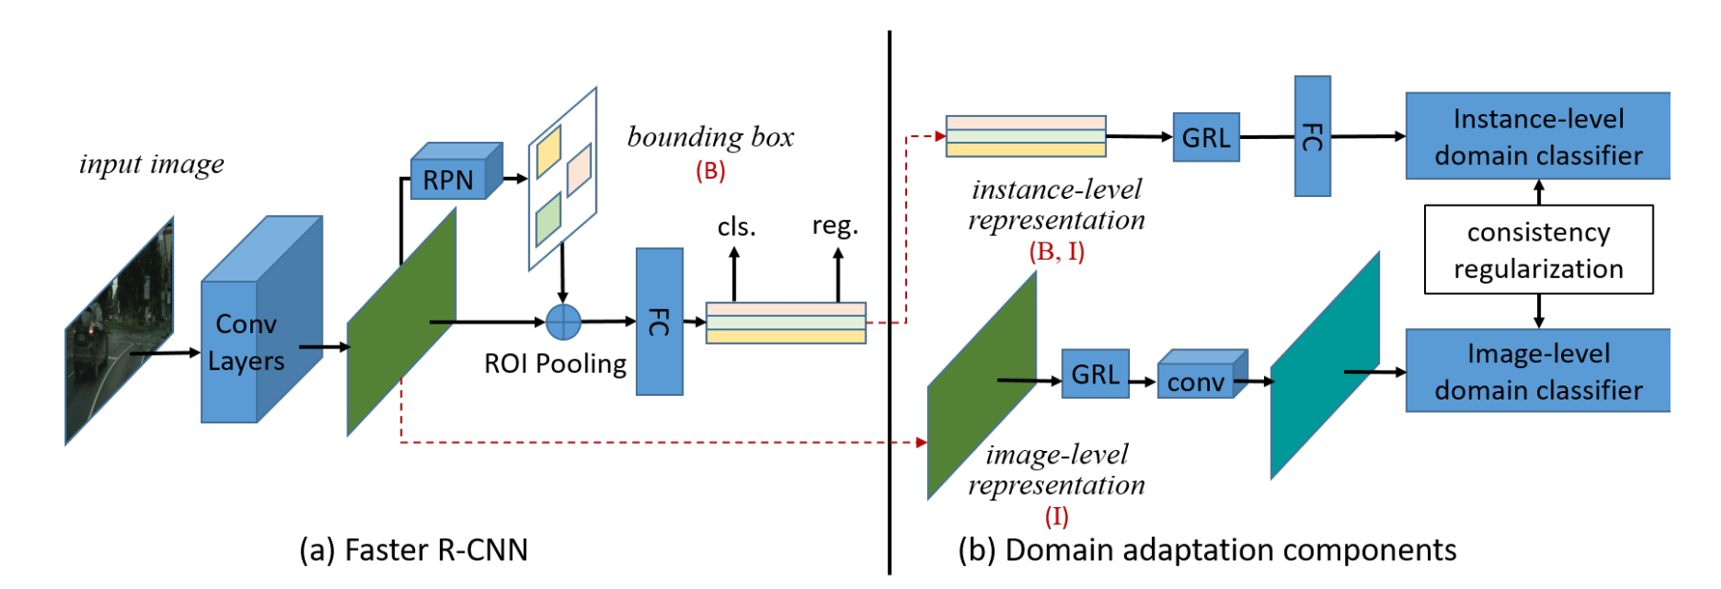
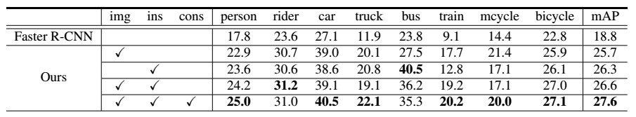
Domain adaptive Faster RCNN
Quantative results of Domain adaptive Faster RCNN on Foggy Cityscapes task
Joint adaptation
Image-level adaptation
Instance-level adaptation
Consistency regularization
Chen et al. CVPR 2018

Slide 5
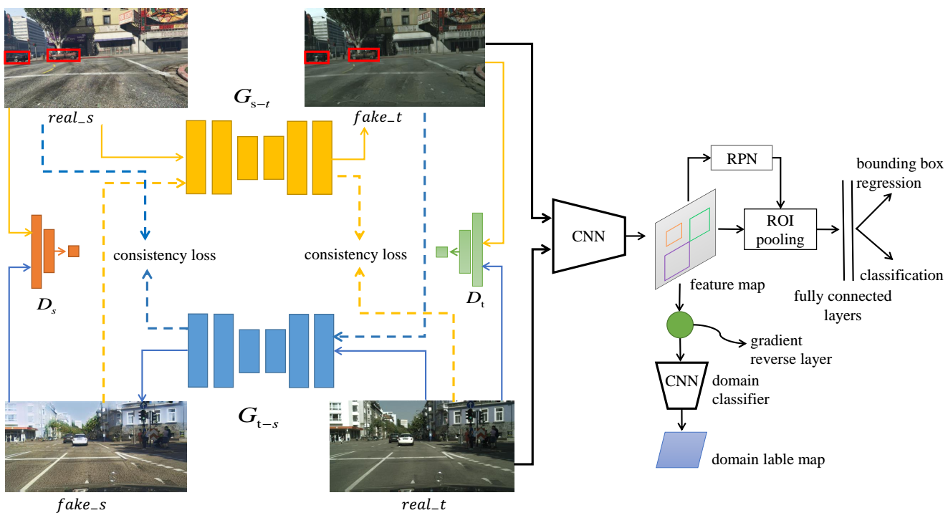
Hybrid domain adaptive object detection framework
Pixel-level domain adaptation (PDA)
Feature-level adaptation (FDA)
Shan et al. Neurocomputing 2018

Slide 6
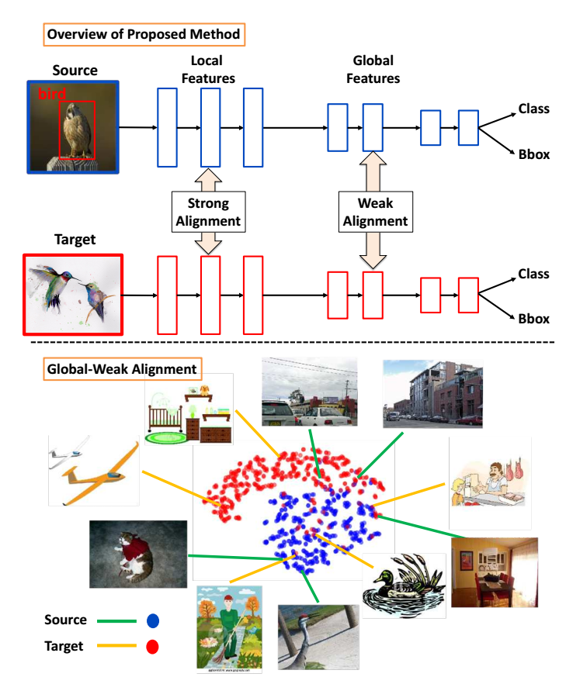
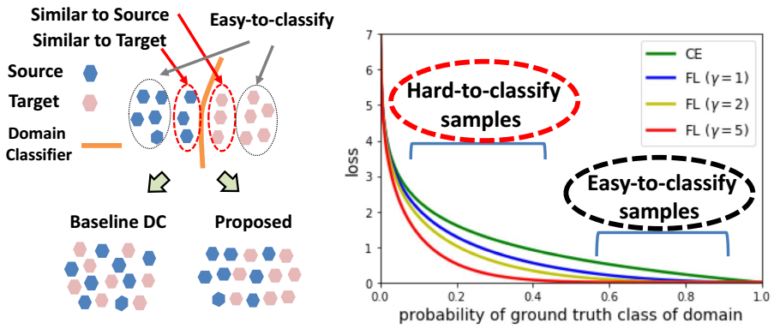
Strong-weak alignment domain adaptive Faster RCNN
Strong-weak models learns domain-invariant features
Strongly aligned at the local patch level
Weakly (partially) aligned at the global scene level
Saito et al. CVPR 2019

Slide 7
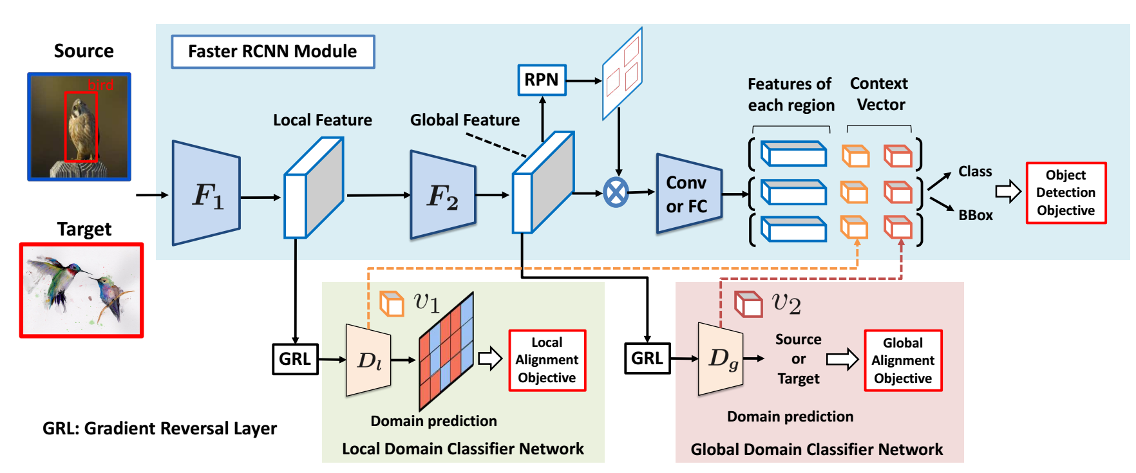
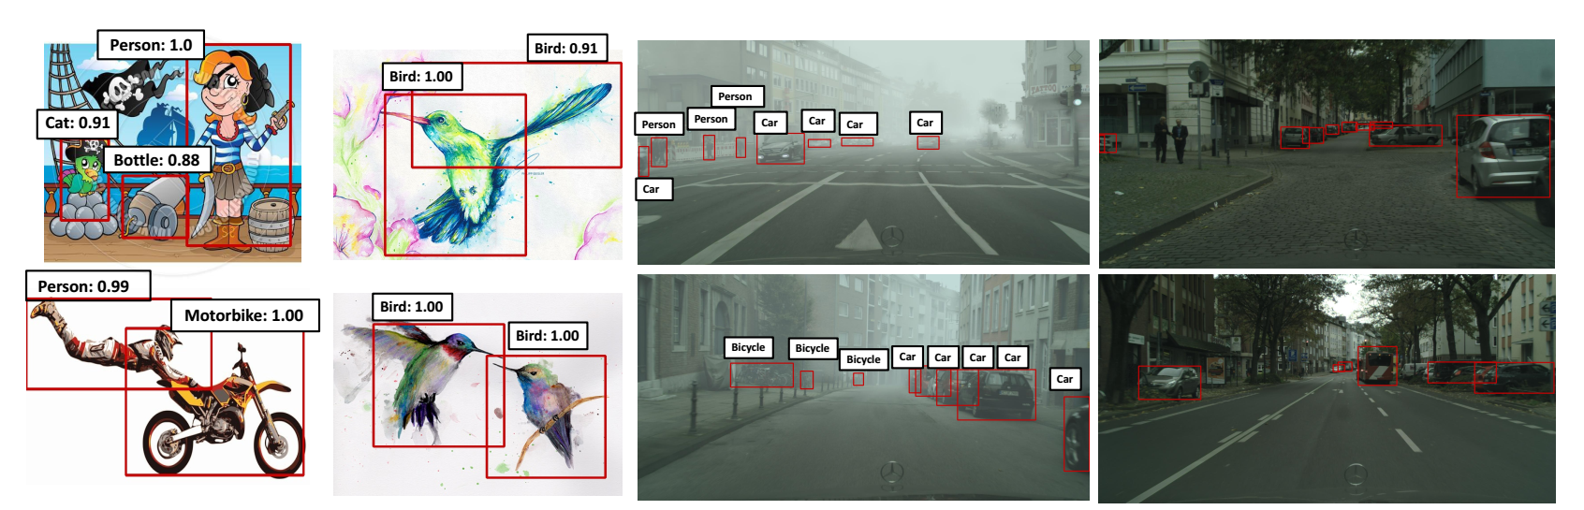
Strong-weak alignment domain adaptive Faster RCNN
Saito et al. CVPR 2019

Slide 8
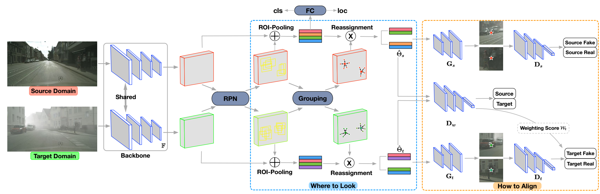
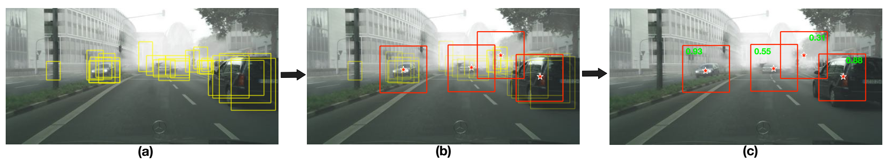
Networks (SCDA)
Region mining (Where to look)
Grouping
Feature assignment
Adjusted region-level alignment (How to align)
Region-level adversarial alignment
Weighting estimator
grouping operation
weighting estimation
Zhu et al. CVPR 2019

Slide 9
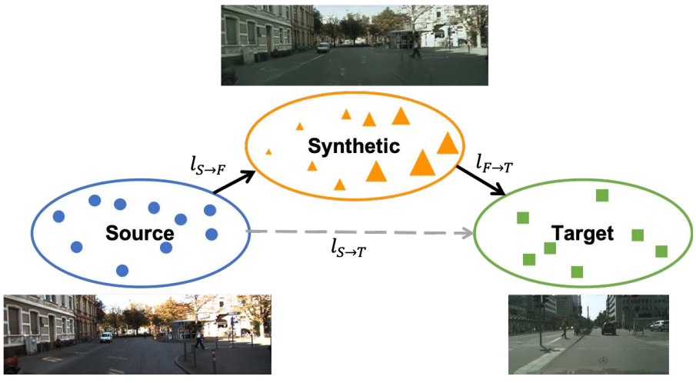
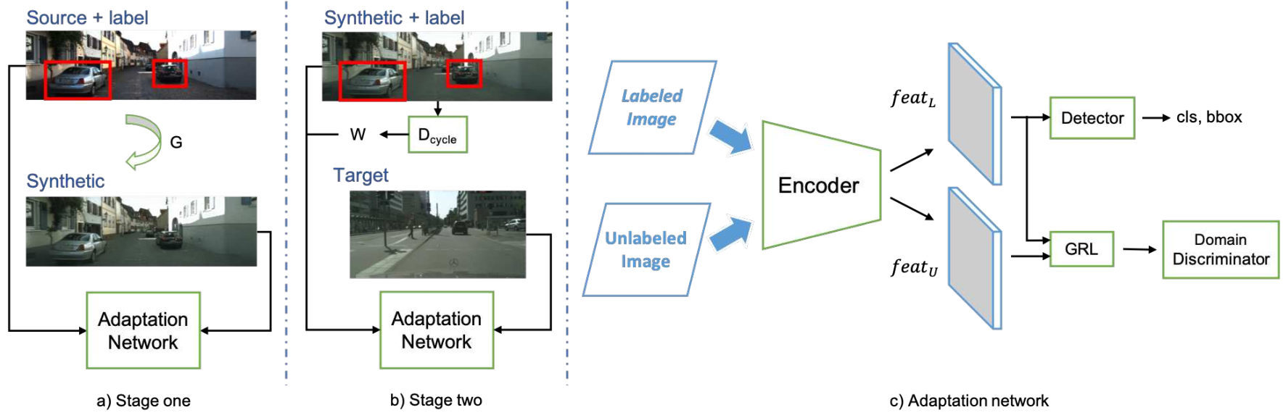
Progressive domain adaption
Adaptation in feature space
Progressive adaptation
Intermediate domain
CycleGAN
Adaptation
Weighted supervision
Hsu et al. CVPR 2019 workshop

Slide 10
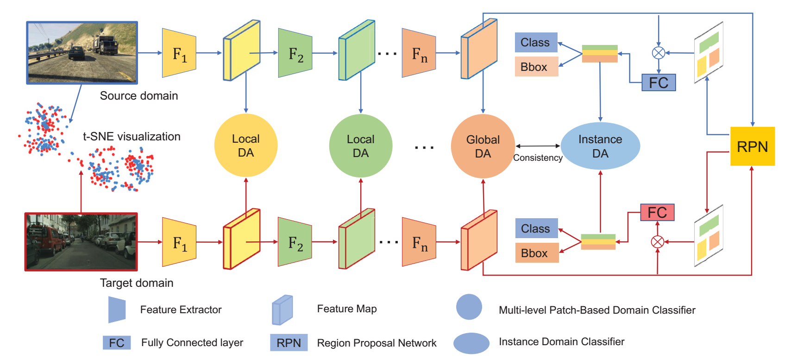
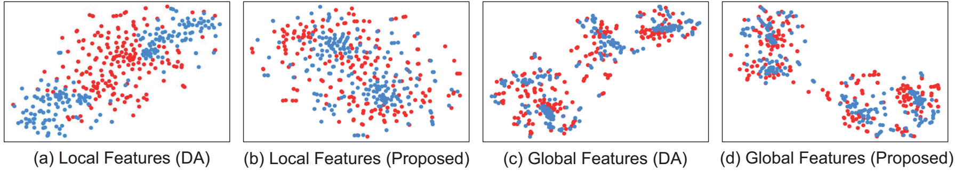
Multi-level domain adaptive learning for cross domain object detection
Xie et al. ICCV 2019 Workshop

Slide 11
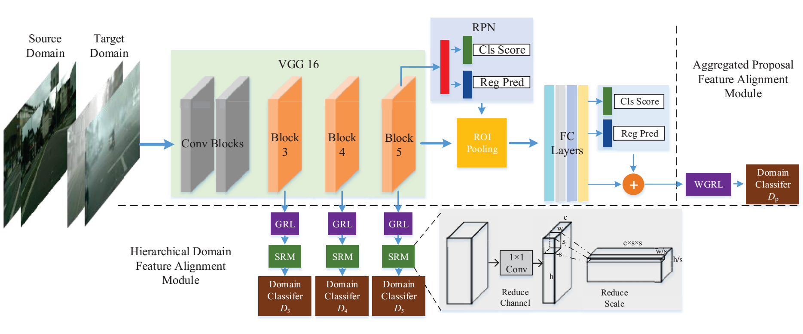
Multi-adversarial Faster RCNN for cross domain object detection
Hierarchical domain feature alignment
Aggregated proposal feature alignment
He et al. ICCV 2019

Slide 12
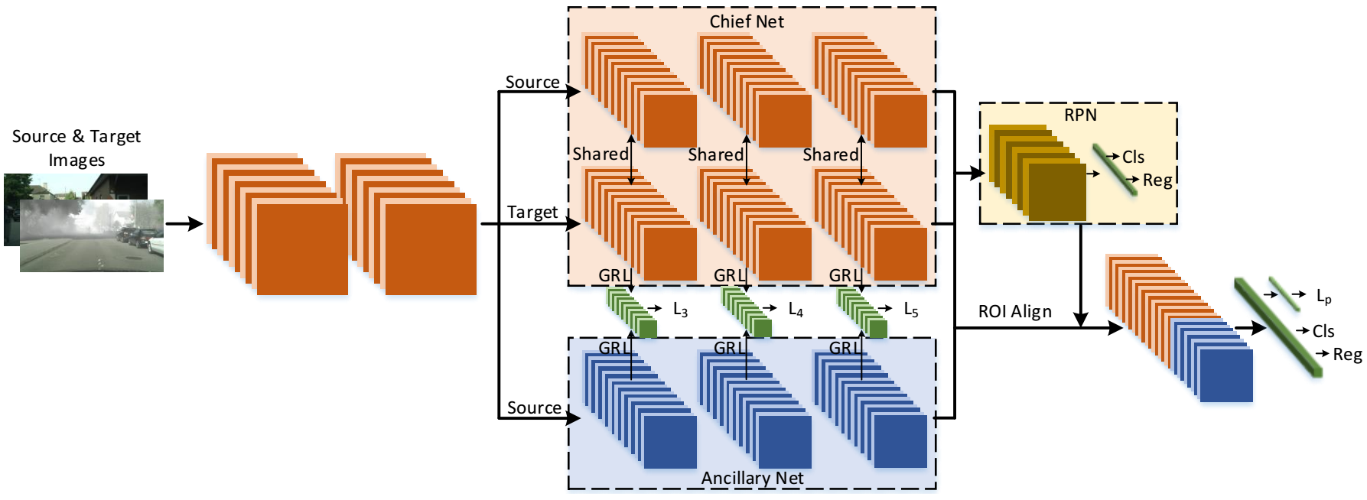
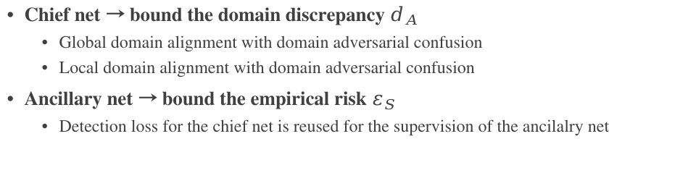
Asymmetric tri-way Faster RCNN for cross domain object detection
Chief net → bound the domain discrepancy $d_{A}$
Global domain alignment with domain adversarial confusion
Local domain alignment with domain adversarial confusion
Ancillary net → bound the empirical risk $ε_{S}$
Detection loss for the chief net is reused for the supervision of the ancilalry net
He et al. ECCV 2020

Slide 13
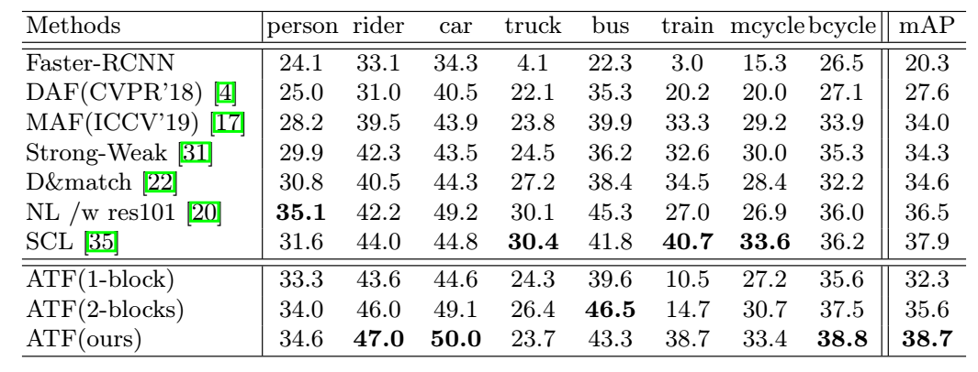
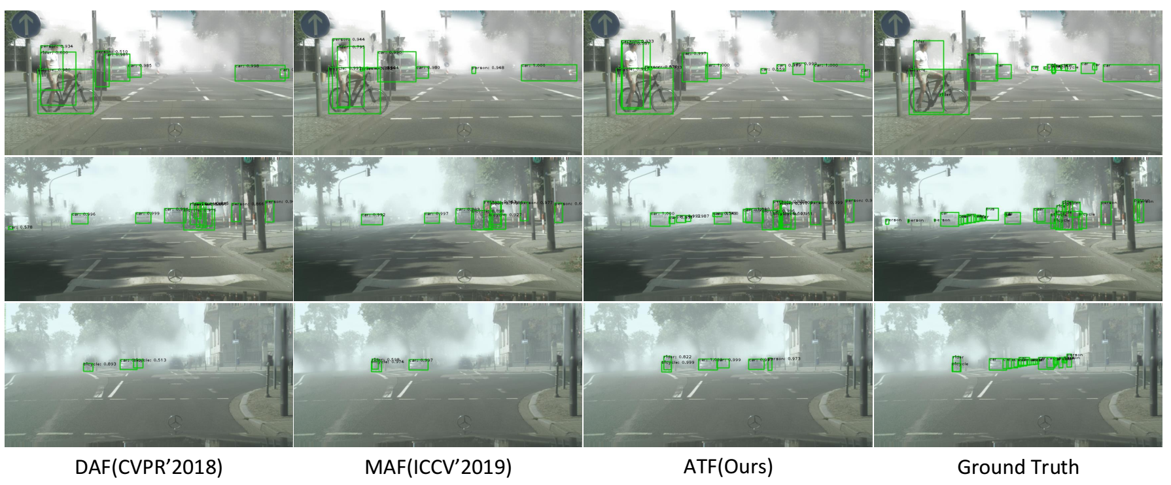
Asymmetric tri-way Faster RCNN for cross domain object detection - quantitative and qualitative results
Quantative and qulitative results on Cityscapes → FoggyCityscapes cross domain object detection task
He et al. ECCV 2020

Slide 14
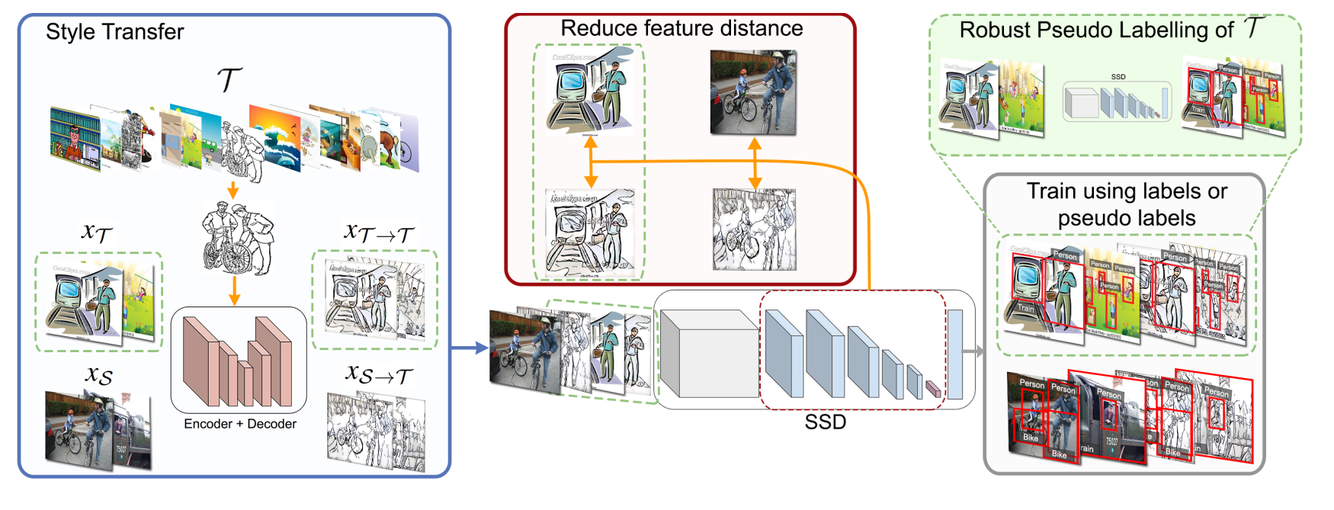
Style consistency domain adaptive object detection
Style transfer with feature consistency
Enforcing feature consistency
Robust pseudo labelling
Positive examples sampling
Negative examples sampling
Combine pseudo labels and style transfer
Chen et al. CVPR 2020

Slide 15
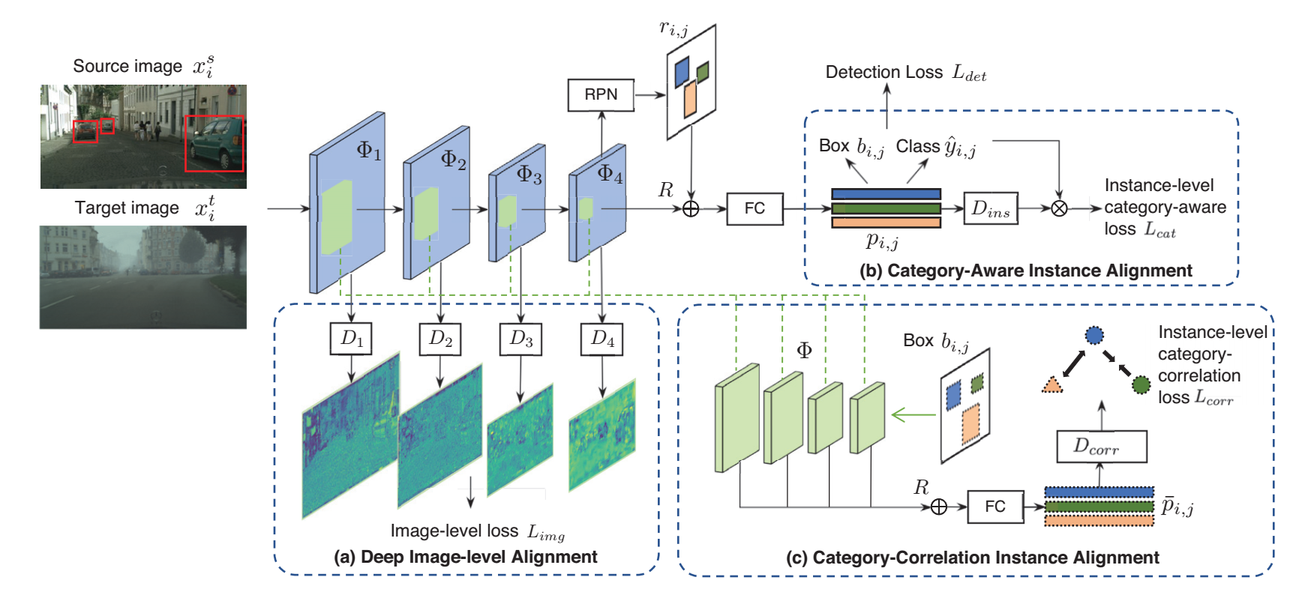
Image-Instance Full Alignment Networks (iFAN)
Deep image-level alignment
Full instance-level alignment
Category-agnostic instance alignment
Category-aware instance alignment
Category-corrleation instance alignment
Zhuang et al. AAAI 2020

Slide 16
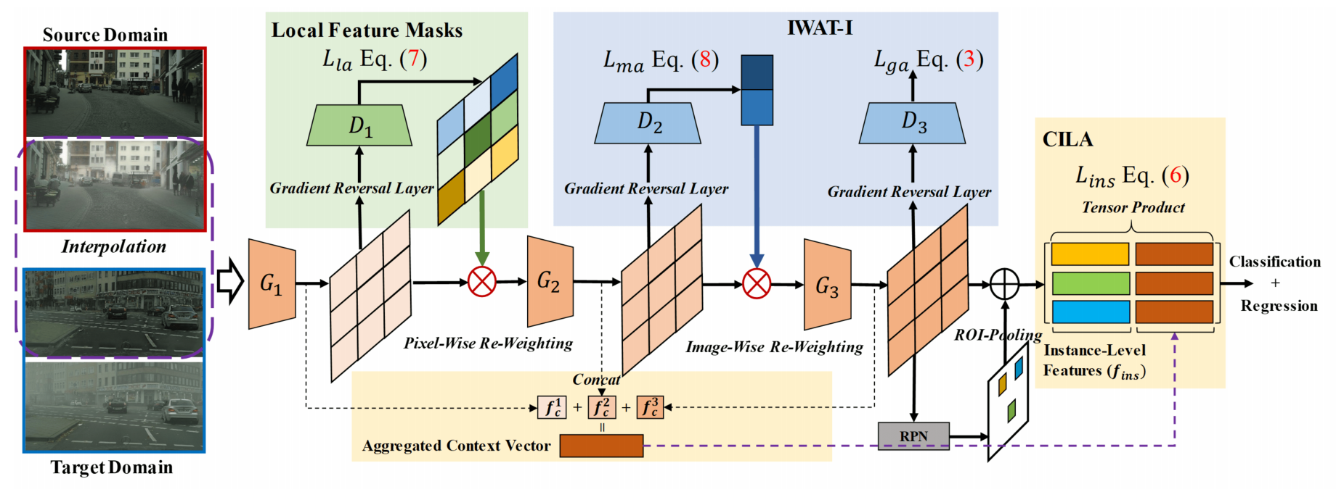
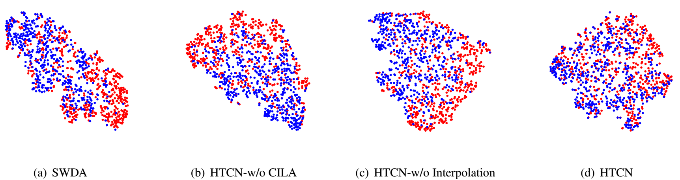
Hierarchical Transferability Calibration Network (HTCN)
Importance weighted adversarial training with input interpolation
Context-aware instance-level alignment
Local feature mask for semantic consistency
Chen et al. CVPR 2020

Slide 17
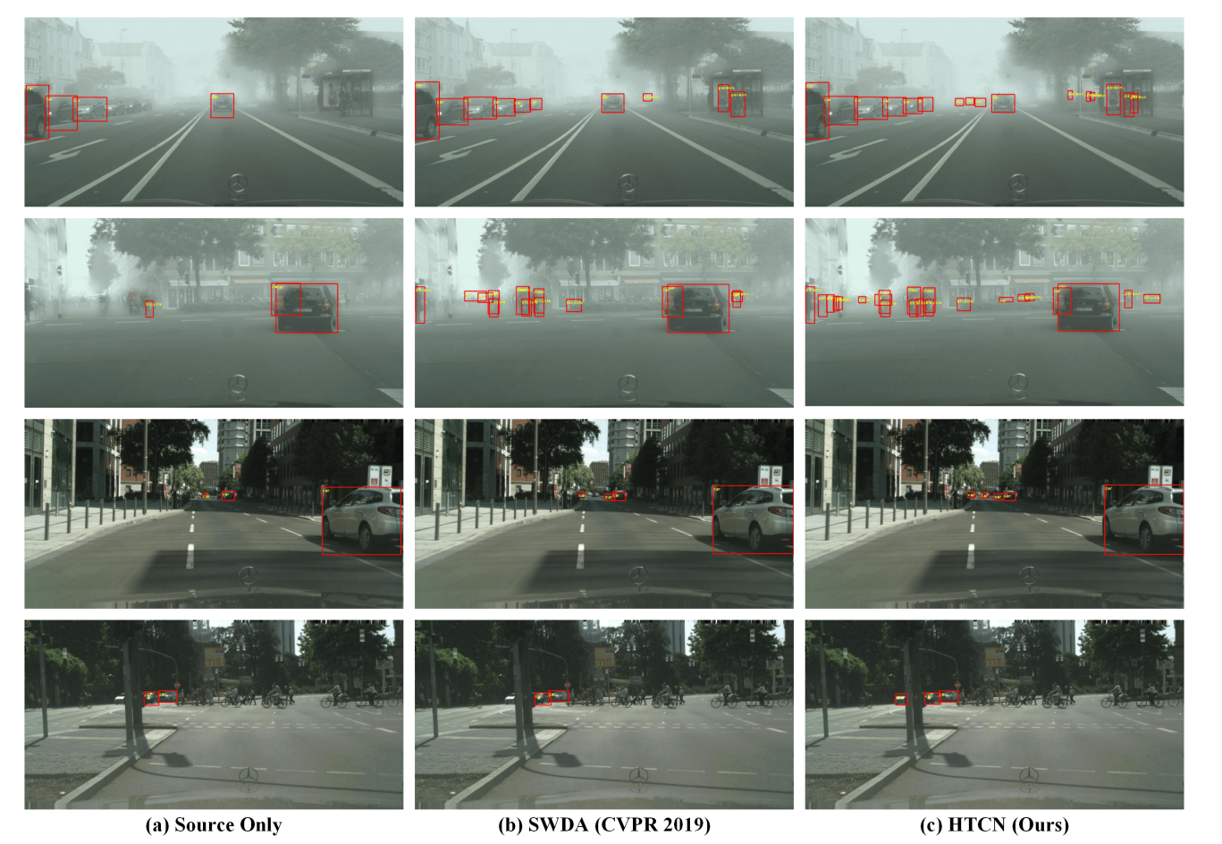
Hierarchical Transferability Calibration Network (HTCN) for cross domain object detection - qualitative results
Chen et al. CVPR 2020

Slide 18
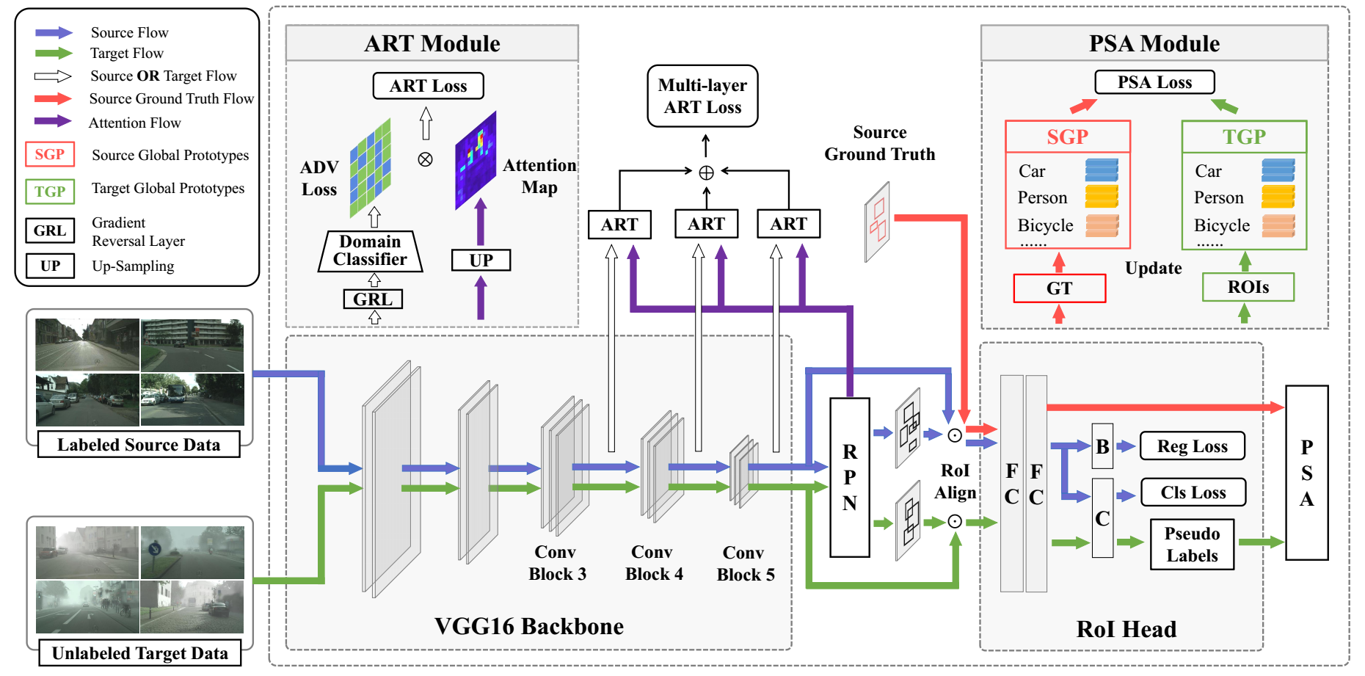
Coarse-to-fine feature adaptation network
Attention-based region transfer (ART)
Prototype-based semantic alignment
Zheng et al. CVPR 2020

Slide 19
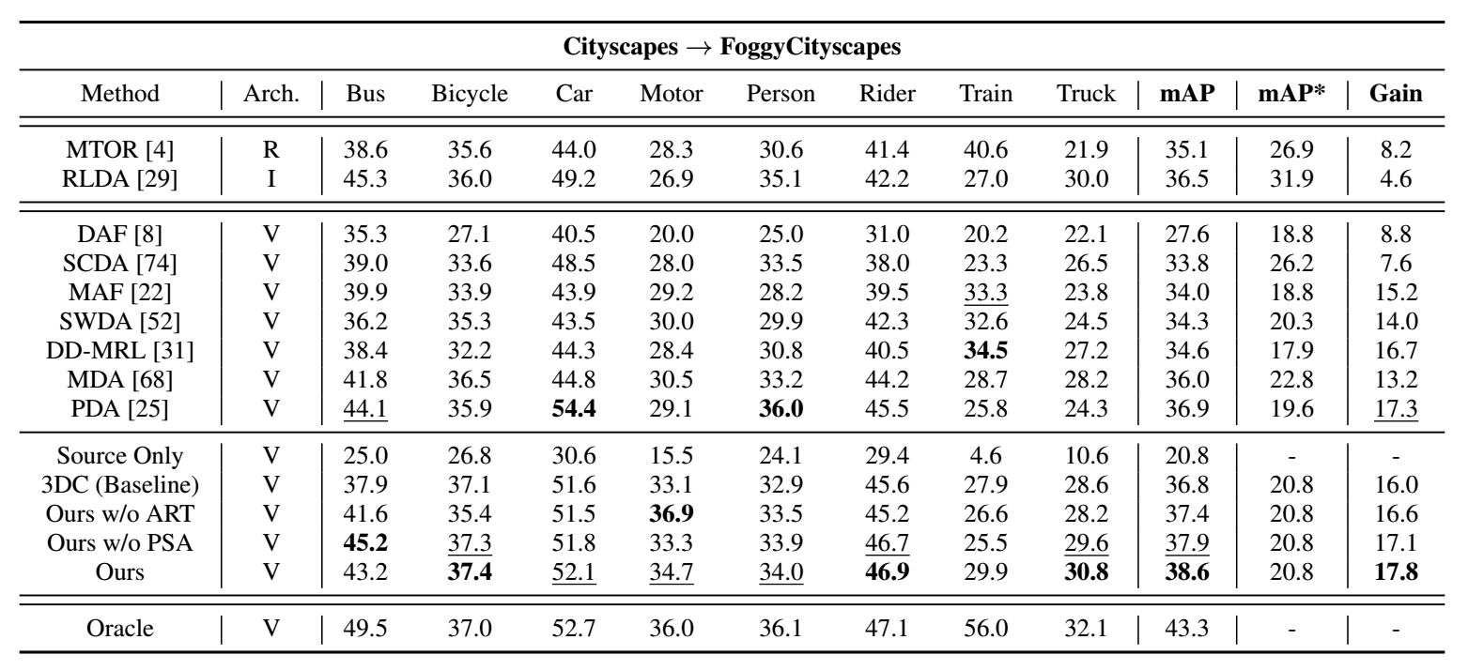
Coarse-to-fine feature adaptation network for cross domain object detection - quantitative results
Quantative results on Cityscapes → FoggyCityscapes cross domain object detection task
Zheng et al. CVPR 2020

Slide 20
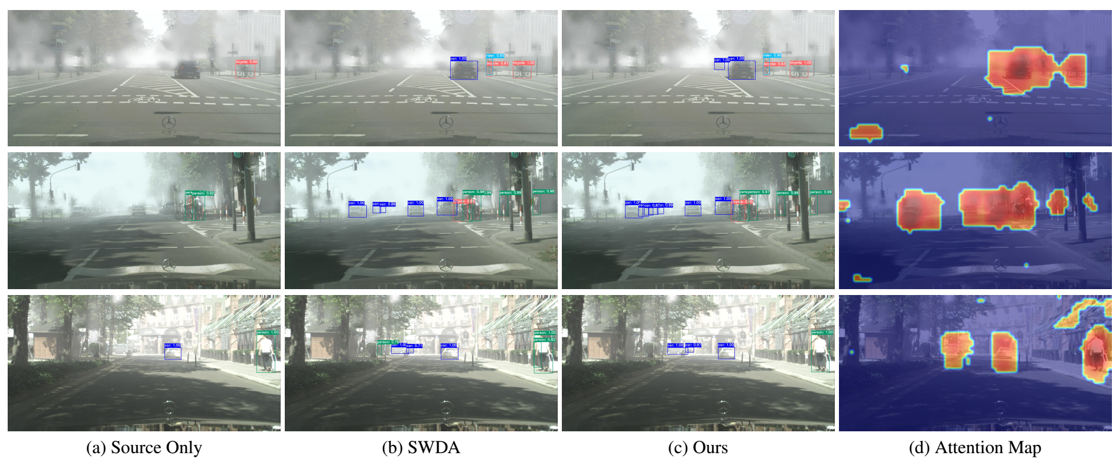
Coarse-to-fine feature adaptation network for cross domain object detection - qualitative results
Zheng et al. CVPR 2020

Slide 21
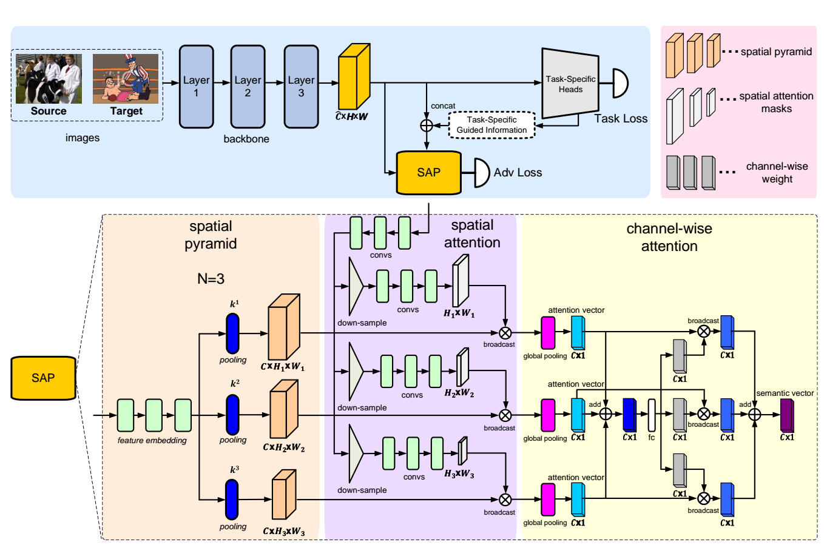
Spatial attention pyramid network
Li et al. ECCV 2020

Slide 22
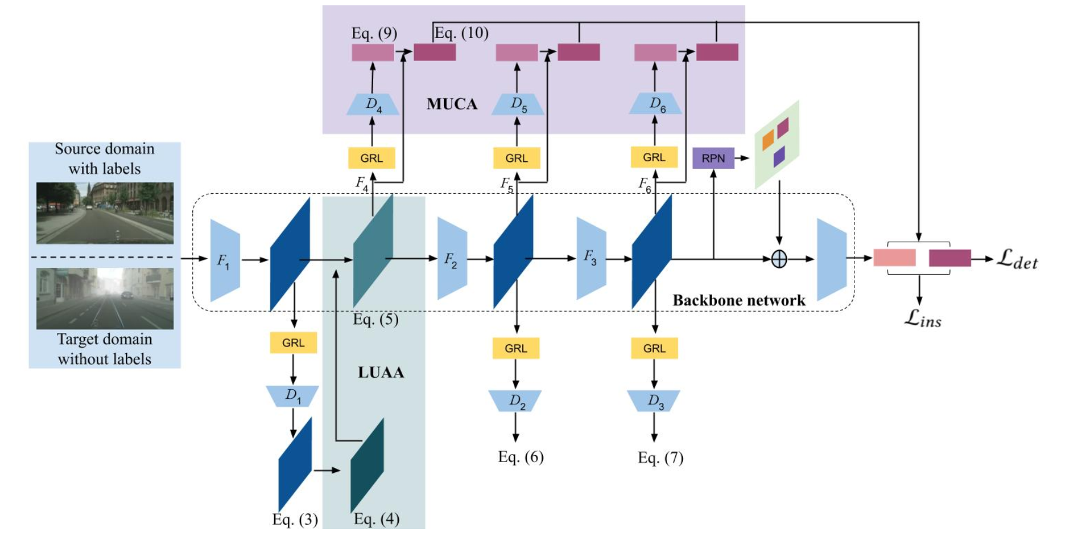
Uncertainty-aware distribution alignment for cross-domain adaptive object detection
Uncertainty-aware attentional alignment module
Multi-level uncertainty-aware context alignment moduel
Nguyen et al. ACM MM 2020

Slide 23
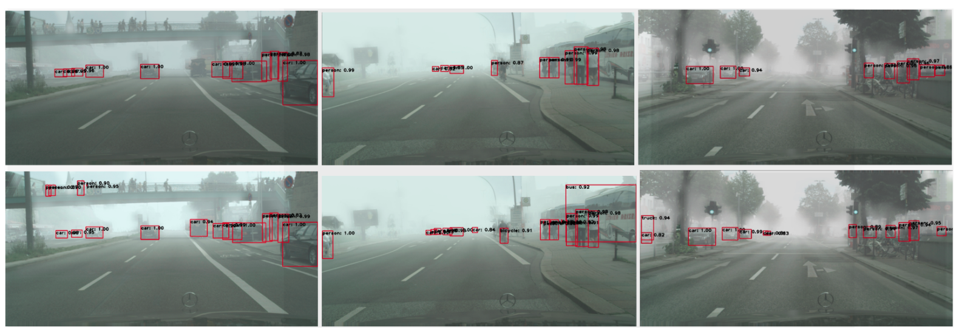
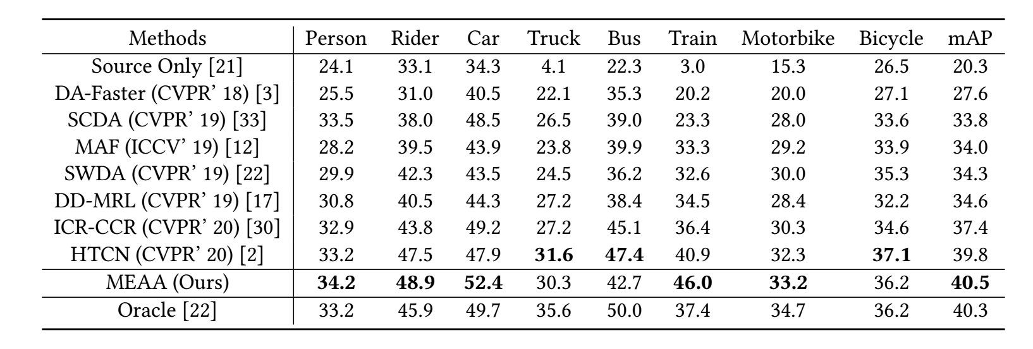
Spatial attention pyramid network
Nguyen et al. ACM MM 2020

Slide 24
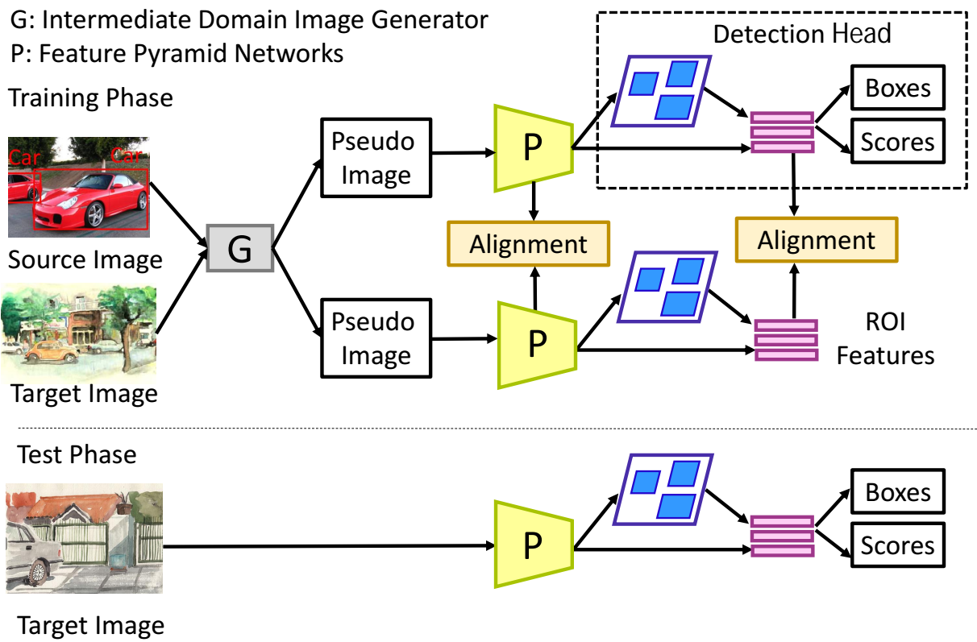
Augmented Feature Alignment Networks (AFAN)
Wang et al. Arxiv 2021

Slide 25
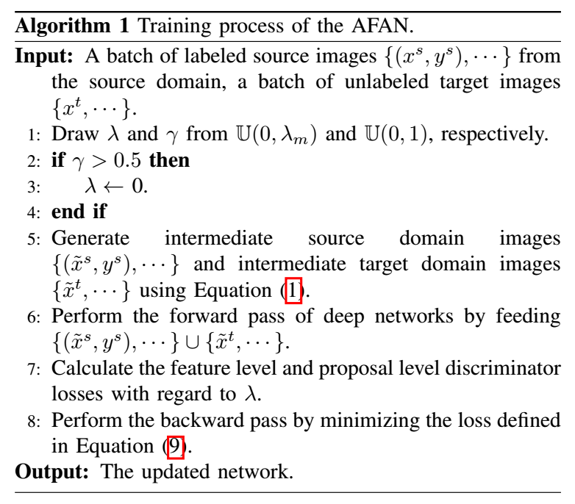
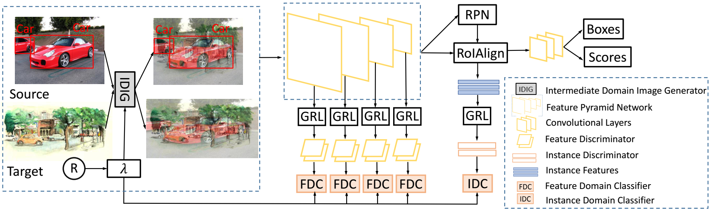
Augmented Feature Alignment Networks (AFAN)
Pseudo image generation
Feature pyramid alignment
Region feature alignment
Object detection head
Wang et al. Arxiv 2021

Slide 26
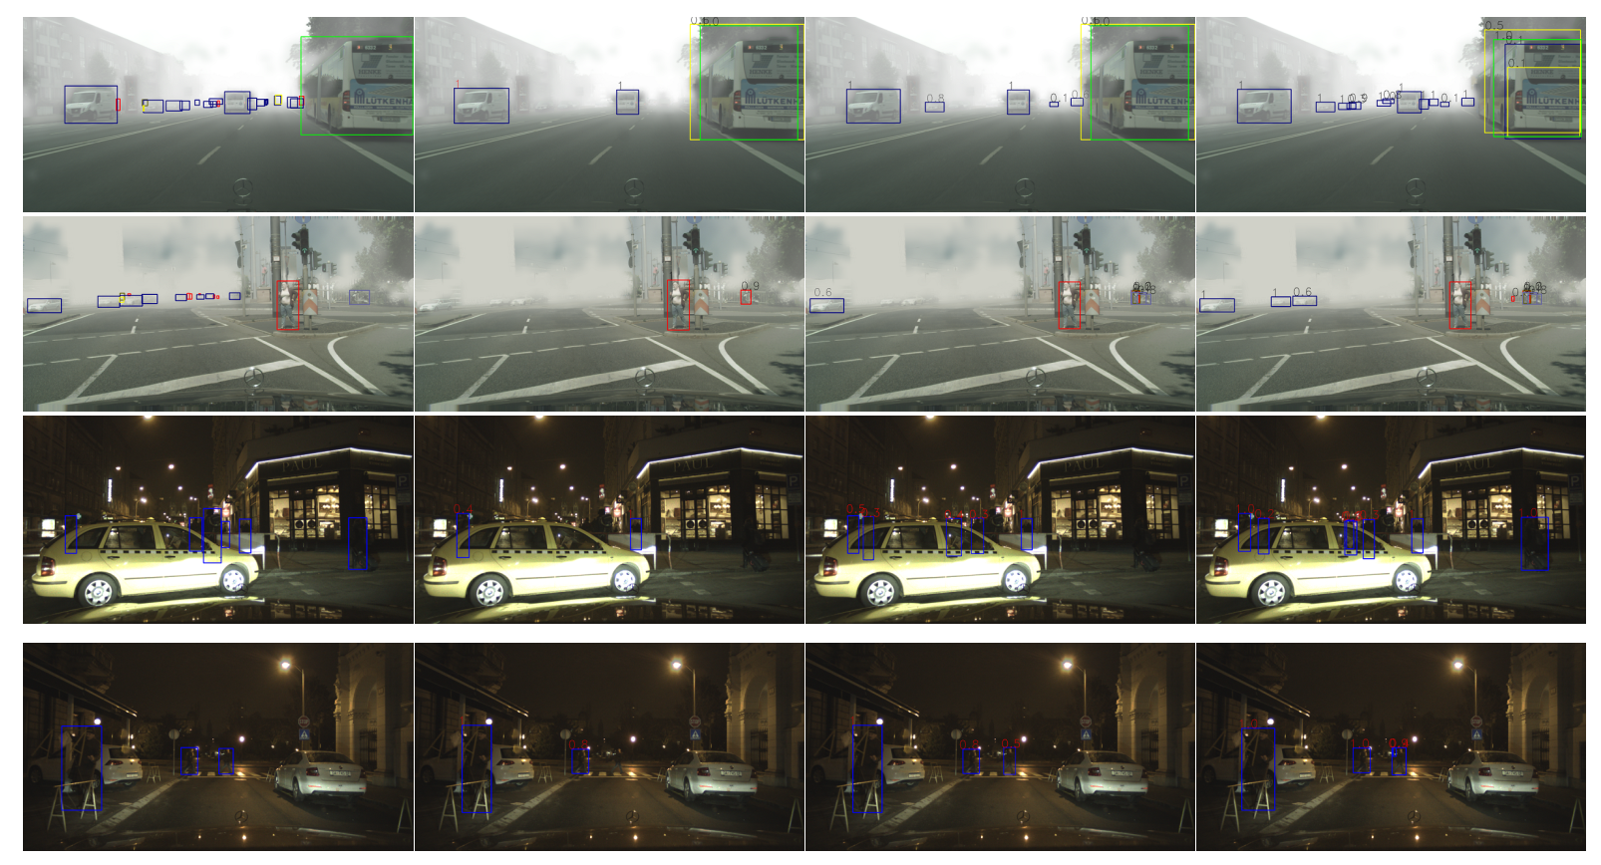
Augmented Feature Alignment Networks (AFAN) for cross domain object detection - qualitative results
Wang et al. Arxiv 2021

Slide 27
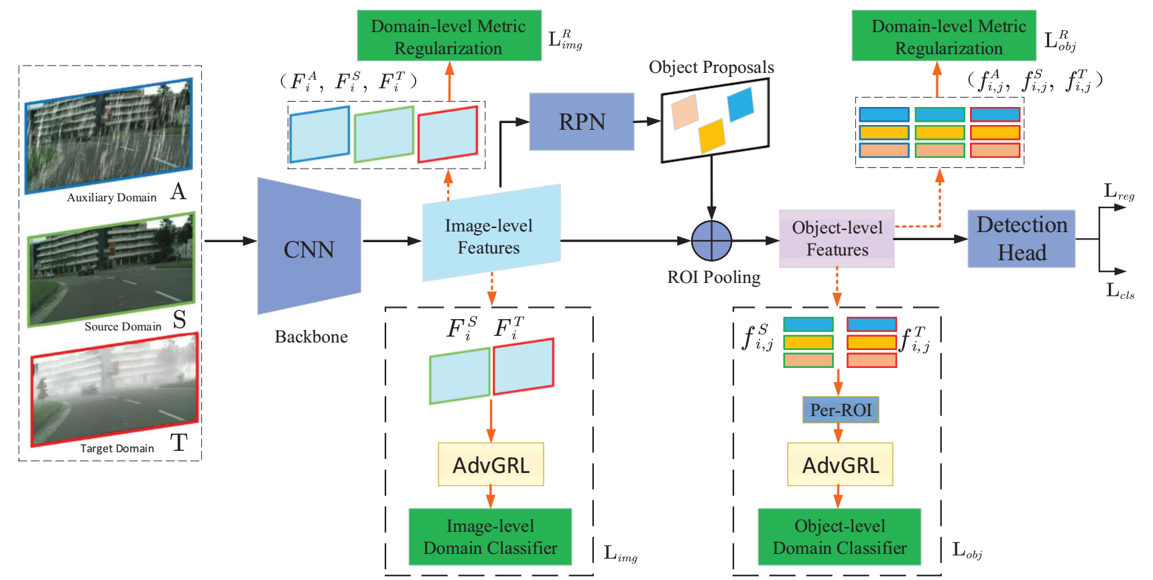
Improved domain adaptive Faster RCNN
Joint adaptation
Image-level adaptation
Object-level adaptation
Adversarial gradient reversal layer
Domain-level metric regularization
Li et al. WACV 2023

Slide 28
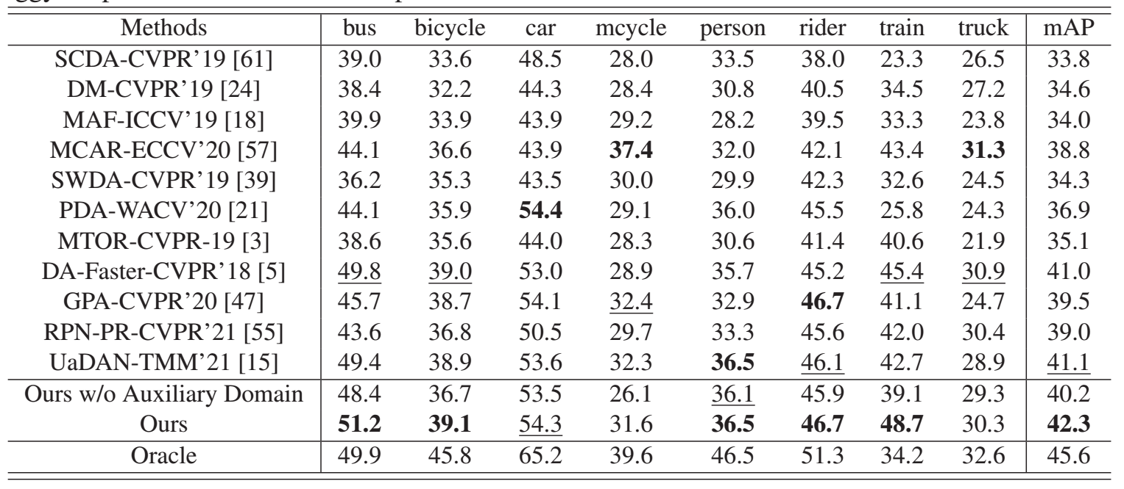
Improved domain adaptive Faster RCNN for cross domain object detection - quantitative results
Quantative results on Cityscapes → FoggyCityscapes cross domain object detection task
Li et al. WACV 2023

Slide 29
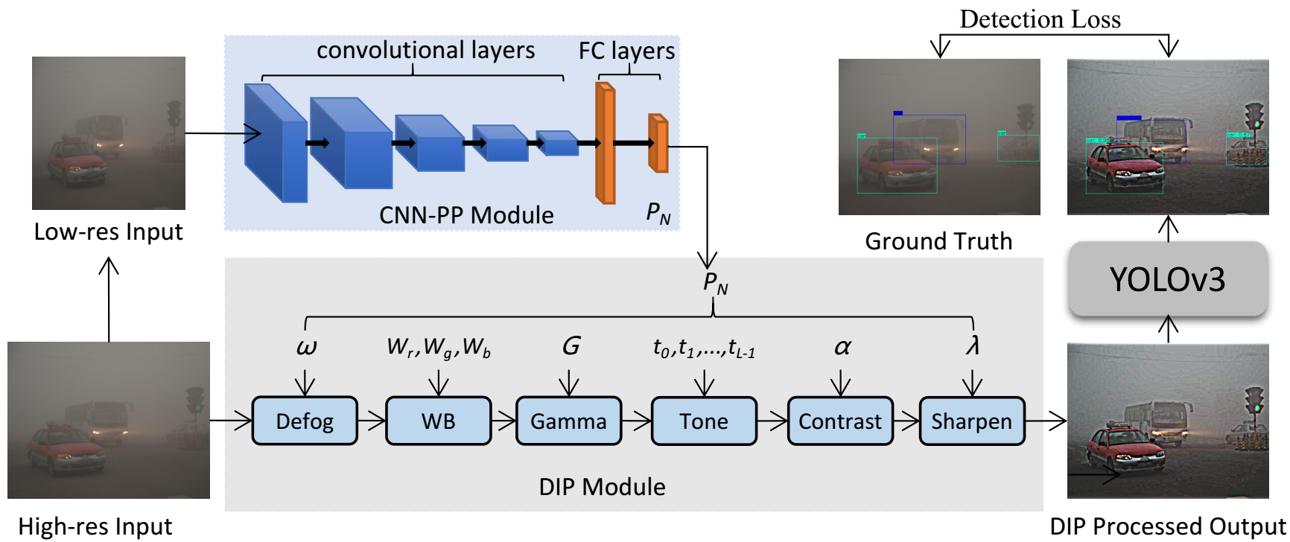
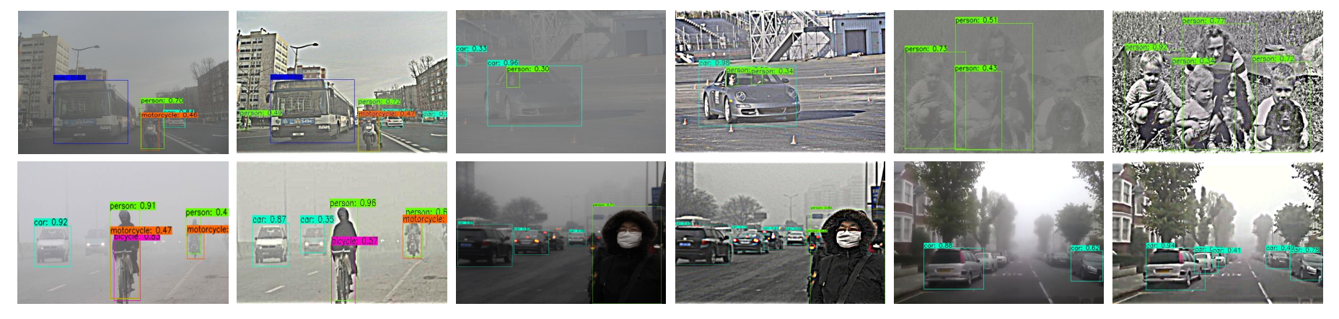
End-to-end training of IA-YOLO framework for cross domain object detection
Liu et al. AAAI 2022

Slide 30
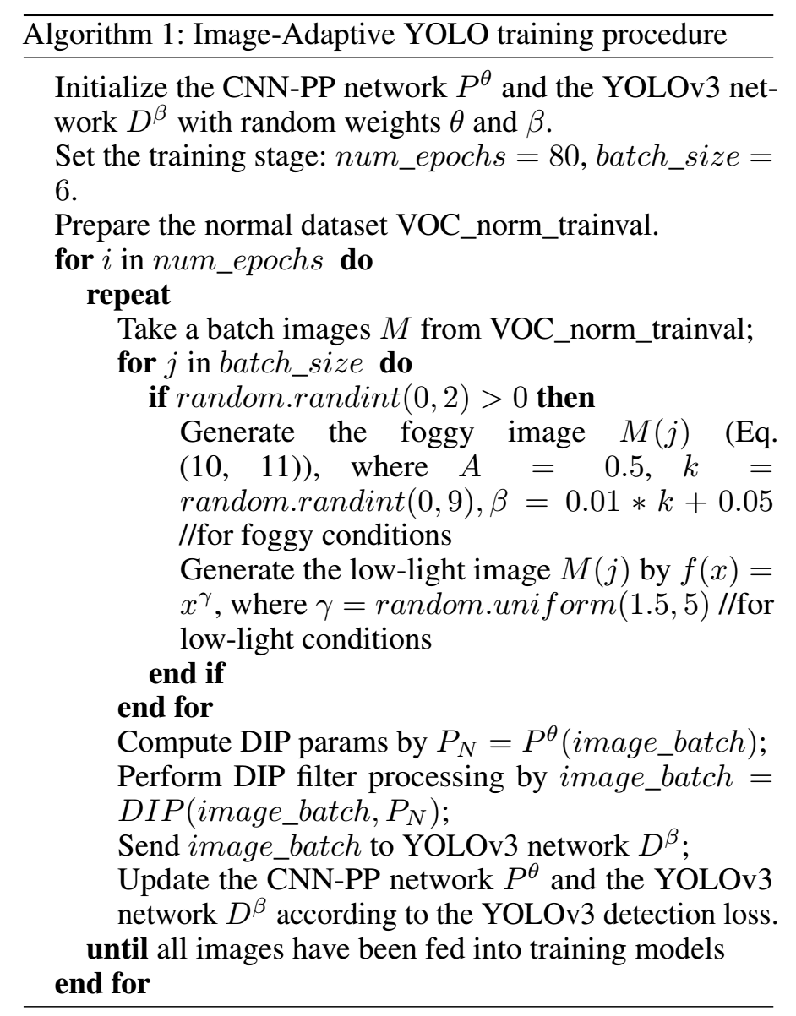
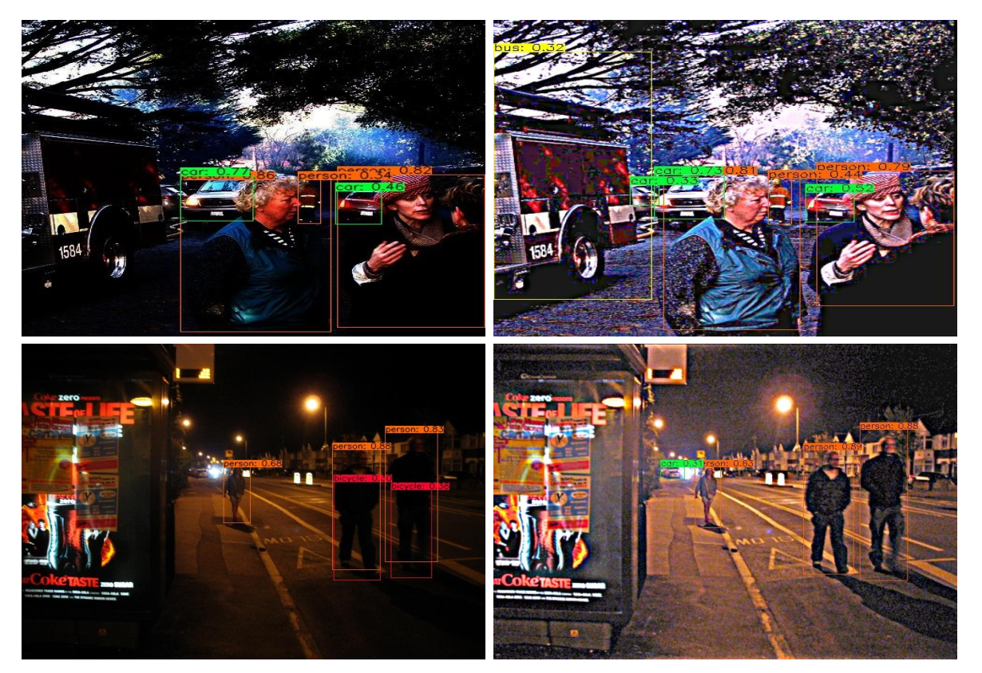
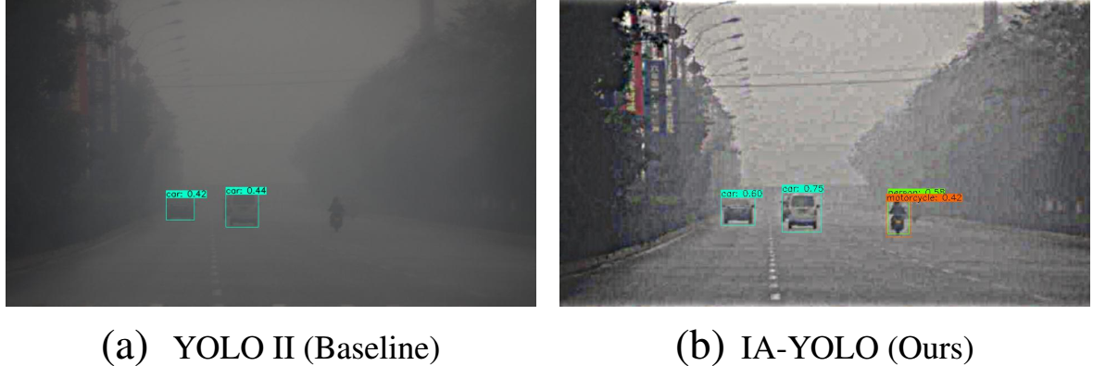
End-to-end training of IA-YOLO framework for cross domain object detection - training procedure
Real-world foggy condition
Liu et al. AAAI 2022

Slide 31
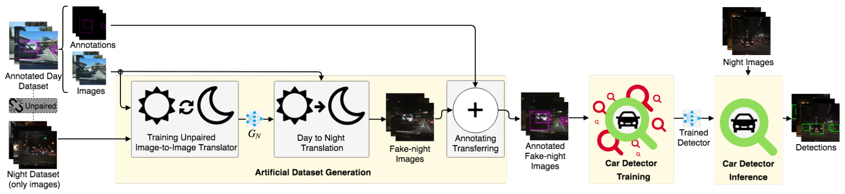
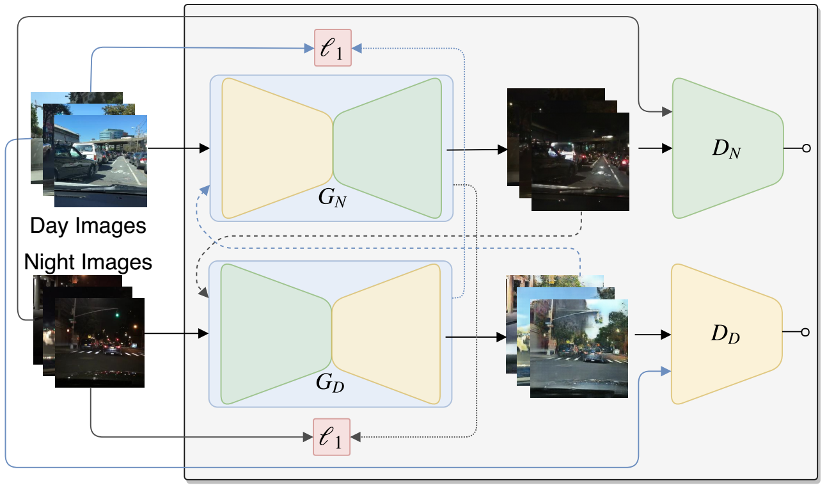
Unsupervised image-to-image (UI2I) translation for cross domain object detection - Entire Framework
Augmented dataset generation in target domain via UI2I translation
CycleGAN
De facto detector training in the target domain
Faster RCNN
FCOS
YOLO series
......
Inference in the target domain
Arruda et al. IJCNN 2019

Slide 32
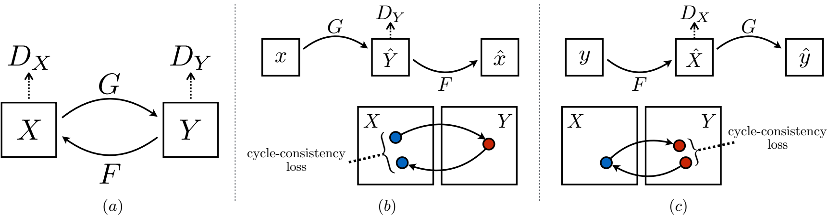
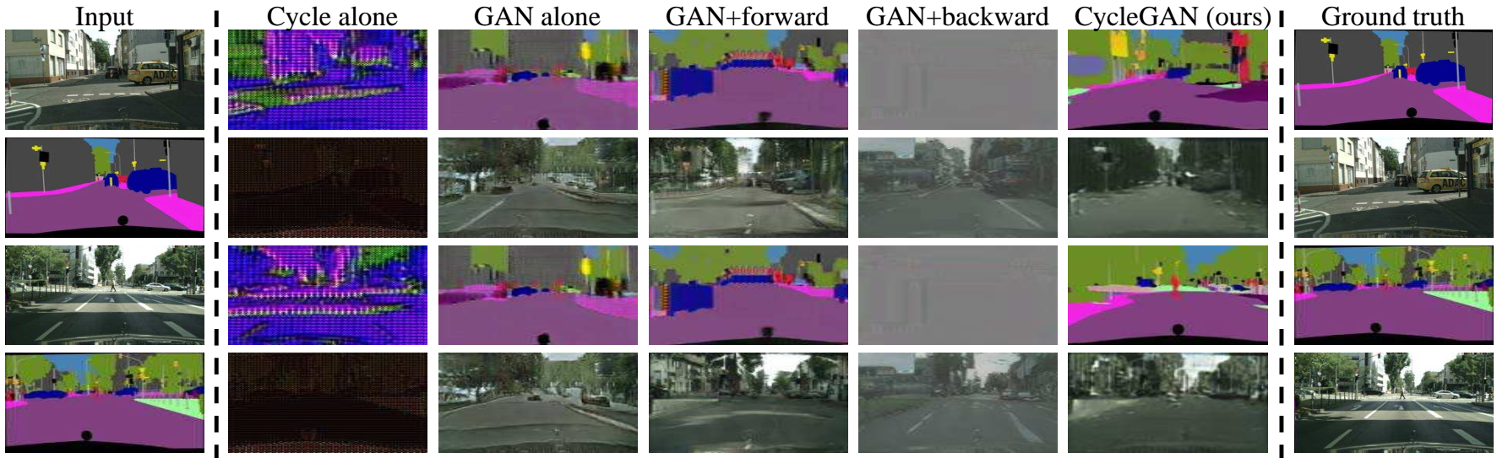
Cycle-consistent generative adversarial networks for unsupervised image-to-image (UI2I) translation
Adversarial loss
Cycle-consistent loss
Zhu et al. ICCV 2017

Slide 33
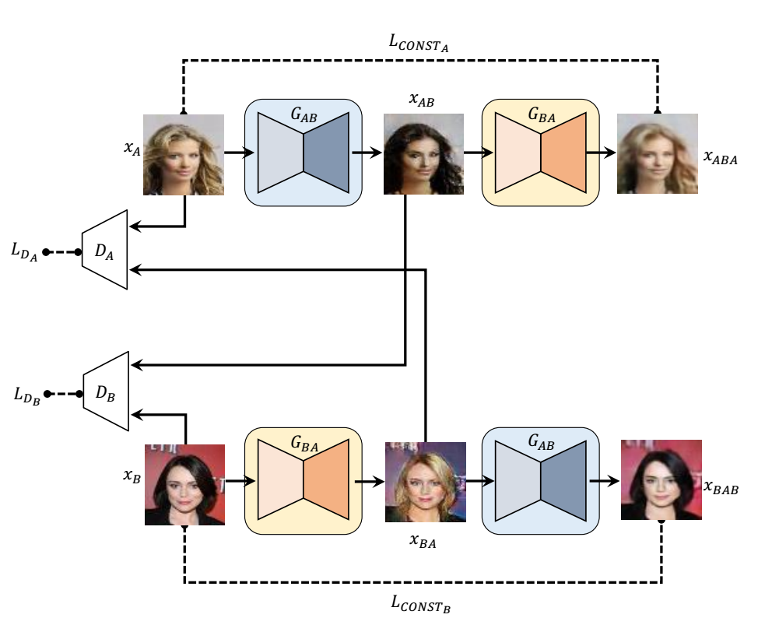
Discover relations between different domains for unpaired image-to-image (I2I) translation
Kim et al. ICML 2017

Slide 34
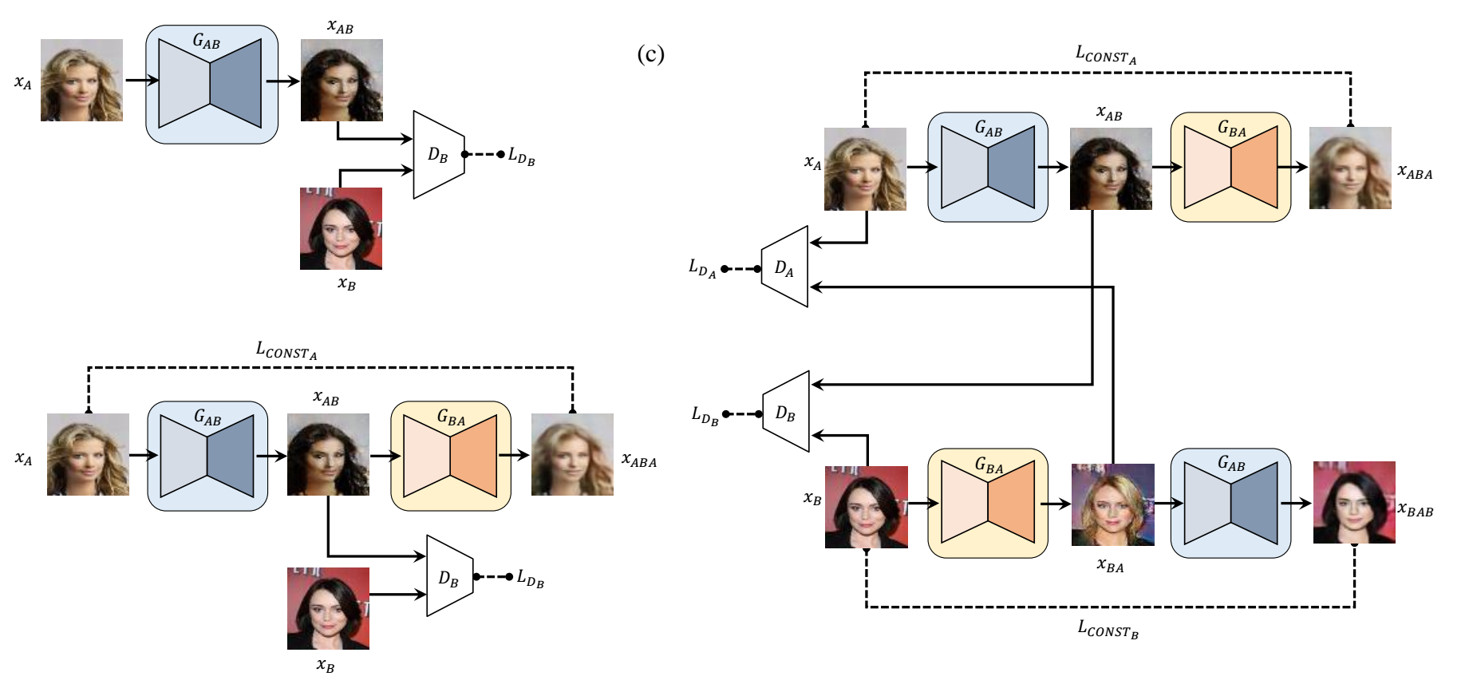
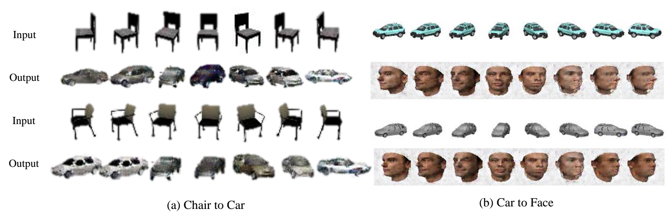
Discover relations between different domains for unpaired image-to-image (I2I) translation
Standard GAN
DiscoGAN
GAN with reconstruction loss
Kim et al. ICML 2017

Slide 35



Unsupervised dual learning for image-to-image (I2I) translation
Yi et al. ICCV 2017

Slide 36

Unsupervised image-to-image (UI2I) translation for cross domain object detection - Entire Framework
Lin et al. AAAI 2020

Slide 37

Unsupervised image-to-image (UI2I) translation for cross domain object detection - annotation transfer process
First row: annotations for the source domain images
Second row: annotations on the source domain images
Third row: transfered annotations on the target domain images
Arruda et al. IJCNN 2019

Slide 38

AugGAN for structure-consistent multimodal unsupervised image-to-image translation
Structure-aware encoding and segmentation subtask
Weight sharing for multi-task network
Cycle-consistency
Adversarial learning
Huang et al. ECCV 2018

Slide 39

Multimodal AugGAN for structure-consistent multimodal unsupervised image-to-image translation
Lin et al. AAAI 2020

Slide 40

Unsupervised image-to-image (UI2I) translation for cross domain object detection - INIT
Shen et al. CVPR 2019

Slide 41

INIT for cross domain object detection - qualitative results
Shen et al. CVPR 2019

Slide 42

Unsupervised image-to-image (UI2I) translation for cross domain object detection - DUNIT
Bhattacharjee et al. CVPR 2020

Slide 43



Unsupervised image-to-image (UI2I) translation for cross domain object detection - DUNIT
Image-to-image translation module
Content adversarial loss
Domain adversarial loss
Cross-cycle consistency loss
Self-reconstruction loss
KL loss
Latent regression loss
Object detection module
Instance consistency loss
Bhattacharjee et al. CVPR 2020

Slide 44


DUNIT for unsupervised image-to-image (UI2I) translation and cross domain object detection - qualitative results
Bhattacharjee et al. CVPR 2020

Slide 45

Patchwise contrastive learning for one-sided unsupervised image-to-image translation (CUT)
Park et al. ECCV 2020

Slide 46

Patchwise contrastive loss
Park et al. ECCV 2020

Slide 47

Contrastive learning for one-sided unsupervised image-to-image translation - qualitative results
Park et al. ECCV 2020

Slide 48

Contrastive learning for one-sided unsupervised image-to-image translation (CUT) - high resolution images synthesis
Park et al. ECCV 2020

Slide 49

Dual contrastive learning for unsupervised image-to-image (UI2I) translation
Patch-based multilayer contrastive learning
Similarity loss
Identity loss
Encourage the mapping to preserve color composition between the input and output
Han et al. CVPR 2021 workshop

Slide 50

Dual contrastive learning for unsupervised image-to-image (UI2I) translation - qualitative results
Han et al. CVPR 2021 workshop

Slide 51
Patch pyramid dual contrastive learning for unsupervised image-to-image translation - qualitative results

Slide 52

Instance-aware image-to-image translation with Transformer
Content and style mixing with Transformers
Instance-aware content and style mixing
Instance-aware position embedding
Kim et al. CVPR 2022

Slide 53

Instance-aware image-to-image translation with Transformer
Building position embedding for regular patches and instance-level patches
Kim et al. CVPR 2022

Slide 54

Instance-aware image-to-image translation with Transformer
Adversarial loss
Global content loss
Instance-level content loss
Image reconstruction loss
Style reconstruction loss
Kim et al. CVPR 2022

Slide 55

Instance-aware image-to-image translation with Transformer - qualitative results
Input
MGUIT
InstaFormer
Sunny → Rainy
Sunny → Cloudy
Kim et al. CVPR 2022

Slide 56


CyCADA
Cycle-consistent adversarial adaptation
Hoffman et al. ICML 2018

Slide 57
Thanks mengunlong@matrixtime.com

